Slide 1
IBM University Engagement Project Submission
“Exploring the Power of Agentic AI with IBM Granite and IBM Bob”

Slide 2

Project Tile – [Fitness Buddy]
Domain of Project – [ Healthcare ]
Student Name | Recent Passport Photo | Email ID | Mobile number [WhatsApp]
SHANI VERMA |  | 2308390100060@reck.ac.in | 8115677411
Recommended font style and size:
Font Style: Arial
Font Size (Heading): 28
Font Size (Content): 20

Slide 3
Problem Statement -
Problem Statement : Fitness Buddy
The Challenge
In today’s fast-paced world, many individuals struggle to maintain a healthy lifestyle due to lack of personalized guidance, time constraints, and inconsistent motivation. Traditional fitness solutions often require expensive subscriptions, in-person consultations, or rigid schedules that don't adapt to personal preferences or daily routines.
The Objective
There is a growing need for an accessible, friendly, and intelligent virtual assistant that can provide on demand fitness advice, healthy lifestyle suggestions, and basic nutrition guidance—all tailored to individual needs and available at any time.
Fitness Buddy aims to solve this problem by offering a conversational, AI-powered health and fitness coach that can:
Recommend home workouts and routines based on user input.
• Provide motivational tips and daily fitness inspiration.
• Suggest simple, nutritious meal ideas.
• Encourage habit-building and consistency.
Technology: Use of IBM cloud lite services /IBM Granity is mandatory.

Slide 4
Proposed Solution -
AI-Powered Fitness Buddy
The proposed Fitness Buddy is an AI-powered virtual fitness and wellness assistant built using IBM watsonx Orchestrate, IBM Granite, and IBM Cloud services. It provides personalized, on-demand guidance to help users maintain a healthy and consistent lifestyle.
The system uses IBM Granite to understand user queries and generate structured recommendations based on fitness goals, fitness level, available time, equipment, and dietary preferences.
Key Capabilities
Workout Assistant – Recommends personalized home workouts and routines.
Nutrition Assistant – Provides basic nutrition guidance and healthy meal suggestions.
Motivation Assistant – Offers fitness motivation and daily inspiration.
Habit Assistant – Helps users build consistent and healthy habits.
Context-Aware Guidance – Adapts recommendations according to user requirements.
IBM watsonx Orchestrate manages the AI agent and its capabilities, while IBM Granite powers reasoning and personalized responses. A dedicated knowledge base provides reliable fitness, nutrition, lifestyle, and safety information.
Overall, Fitness Buddy acts as a smart and accessible digital fitness companion that helps users improve their workouts, nutrition, motivation, and healthy habits.

Slide 5
Technology Used
IBM Bob platform -For designing and orchestrating multi-agent workflows visually
IBM Grainte model - for eg – ibm-granite-3-2-8b – For natural language understanding, reasoning, and personalization
IBM Cloud – It provides the infrastructure to build, deploy, and scale the Nutrition Agent efficiently. IBM Cloud enables a reliable, secure, and scalable environment for deploying the Nutrition Agent.
RAG– RAG to fetch real data first, then generate intelligent answers, making the Nutrition Agent more trustworthy and effective.
IBM Watsonx.ai - For model deployment, embeddings, and AI governance
Vector Database (FAISS/Chroma) – For RAG-based nutritional data retrieval

Slide 6
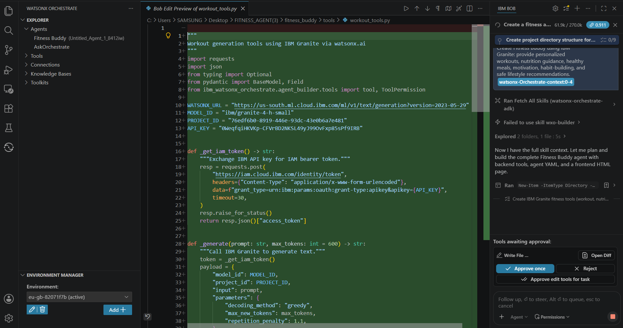
Required Files created using IBM bob -

Slide 7
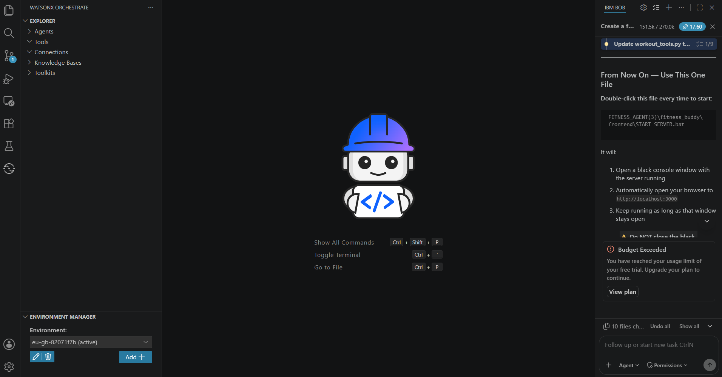
IBM Bob Screenshots:

Slide 8


Slide 9
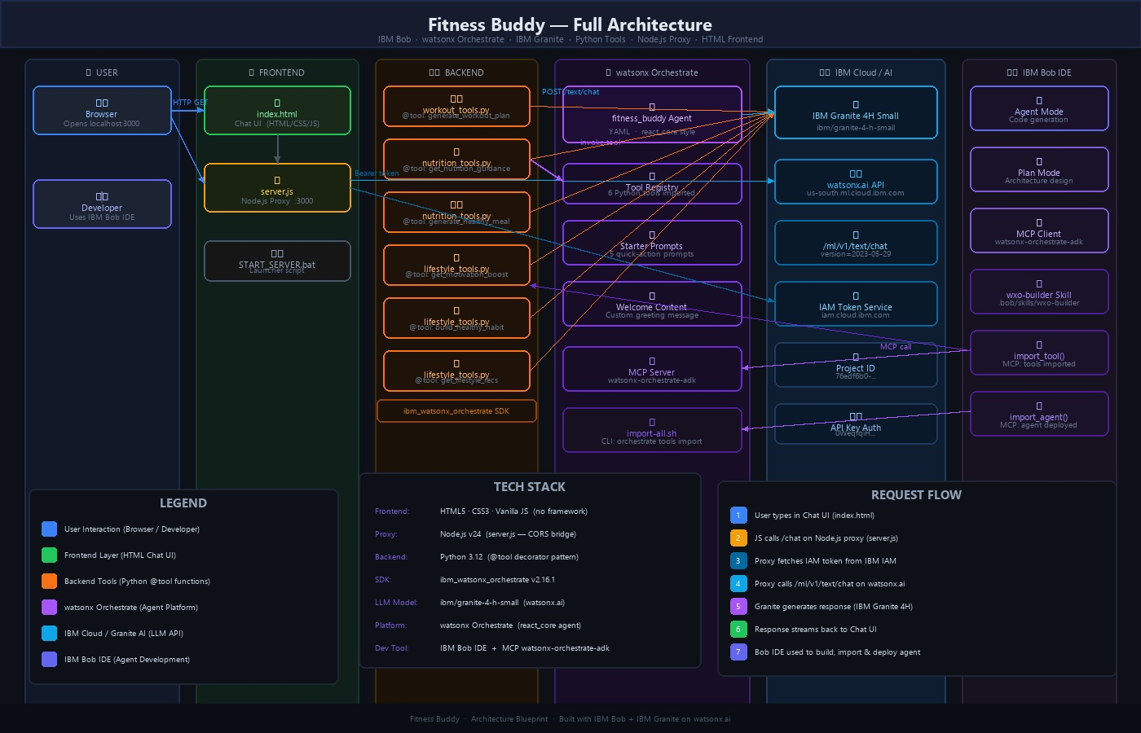
Architecture blueprint for IBM bob:

Slide 10

Role of Agentic AI in the solution
Role of Agentic AI in Fitness Agent
Agentic AI enables Fitness Agent to function as an intelligent and personalized fitness assistant rather than a simple chatbot. Using IBM watsonx Orchestrate and IBM Granite, it understands user requests and provides relevant fitness, nutrition, lifestyle, and motivational guidance.
The agent performs specialized tasks such as generating home workout routines, suggesting healthy meals, providing basic nutrition guidance, offering motivation, and supporting habit-building. These capabilities work together to provide users with practical and structured recommendations.
Agentic AI also provides context awareness, considering details such as the user's fitness level, goals, available time, equipment, dietary preferences, and daily routine to generate personalized suggestions. It can adapt recommendations when users change their requirements, such as having less workout time or different equipment.
Additionally, the agent follows defined safety and domain guidelines, ensuring that responses remain focused on fitness and wellness while avoiding medical diagnosis or unsafe recommendations.
Overall, Agentic AI makes Fitness Agent proactive, personalized, adaptive, and goal-oriented, acting as a smart digital fitness companion that helps users build healthier habits and maintain consistency in their daily lifestyle.

Slide 11
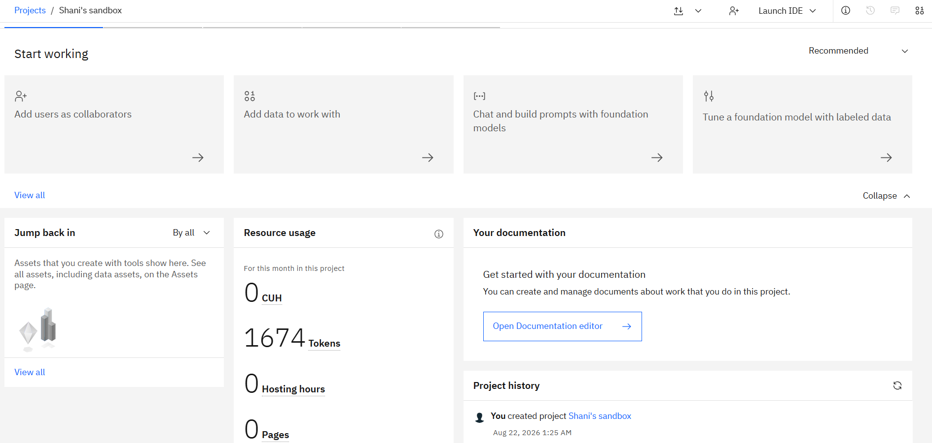
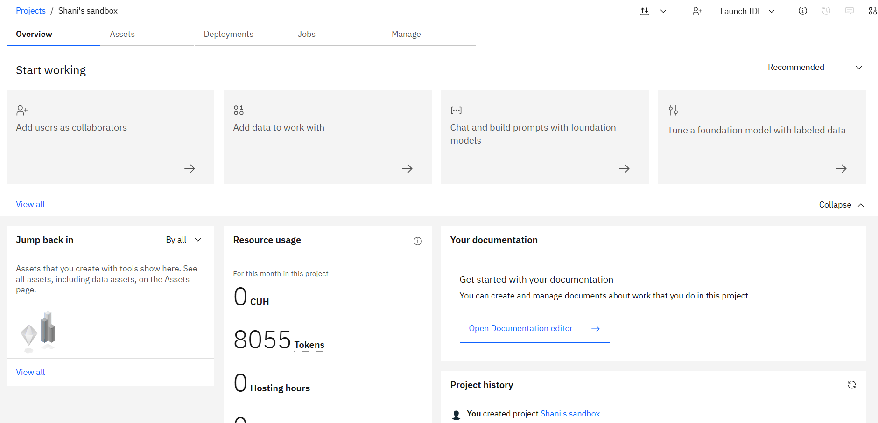
Token Usage
11,761 token are used
Before Prompt
After the Prompt
·
·
·

Slide 12
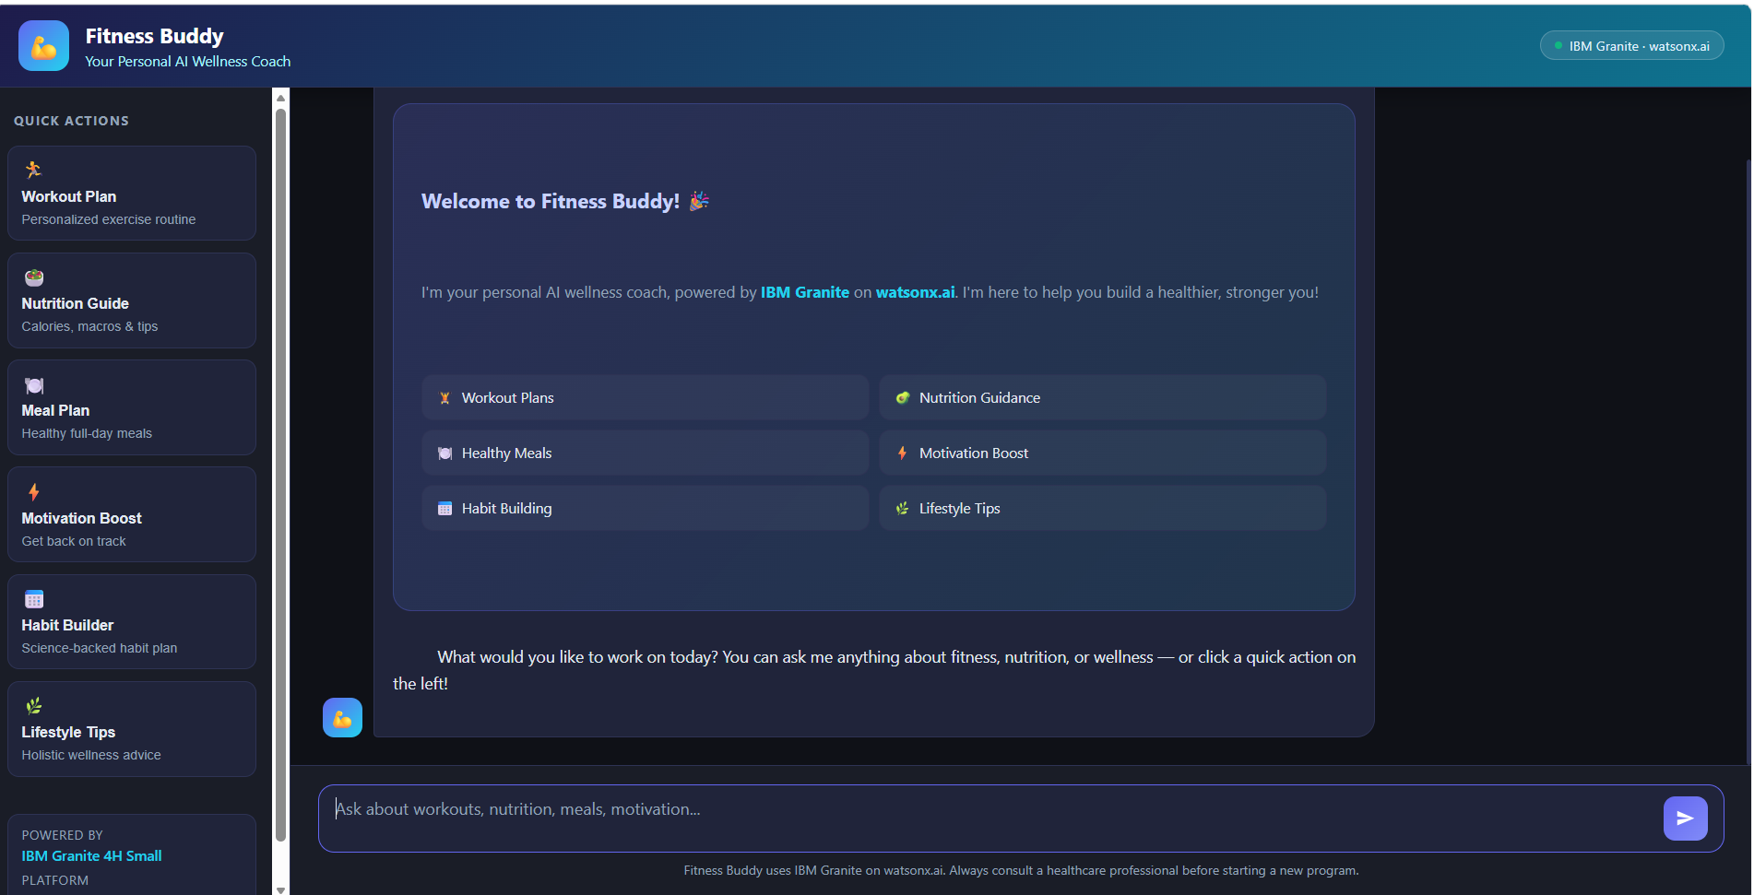
Project Output Screenshot
Please put IBM Bob output screenshots with 2-3 prompts.
You can take 2-3 more slides for each screenshot
·
·
·

Slide 13
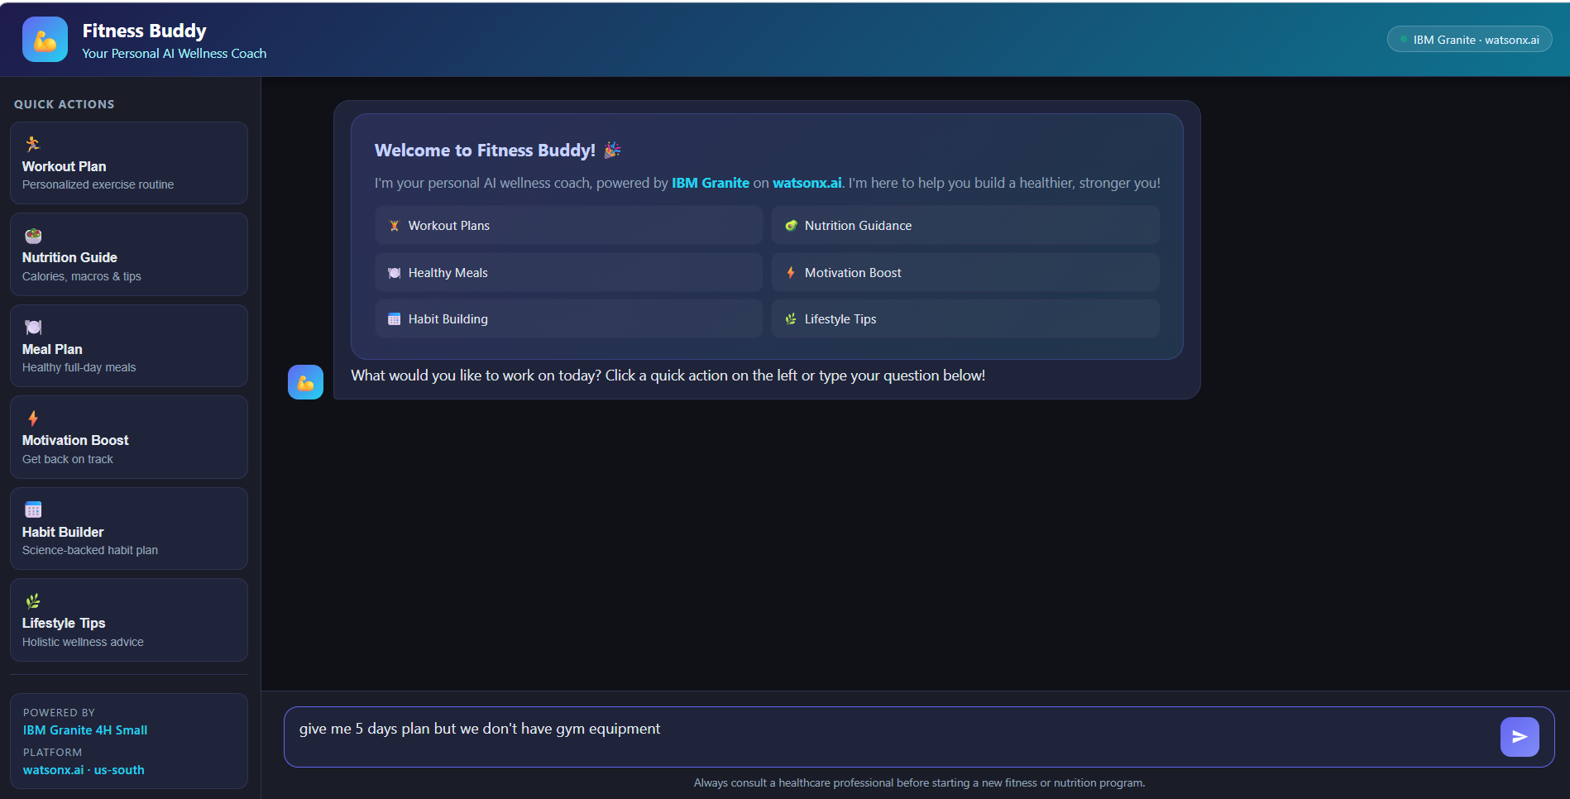
Project Output Screenshot
Please put IBM Bob output screenshots with 2-3 prompts.
You can take 2-3 more slides for each screenshot
·
·
·

Slide 14
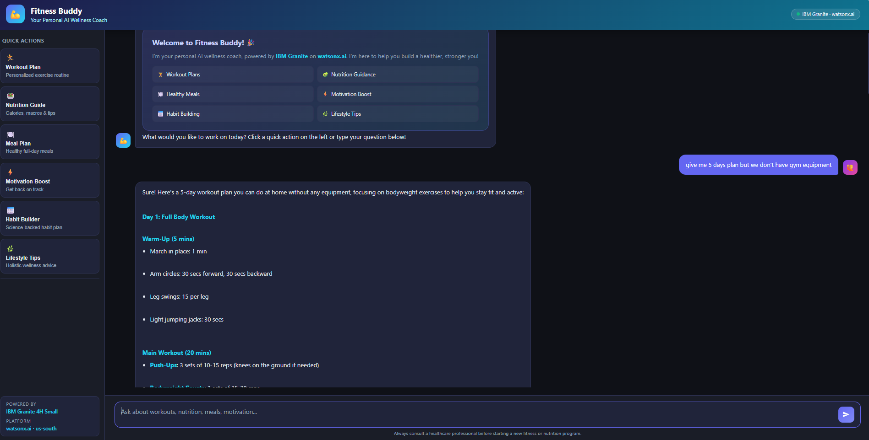
Project Output Screenshot
Please put IBM Bob output screenshots with 2-3 prompts.
You can take 2-3 more slides for each screenshot
·
·
·

Slide 15
Novelty and Uniqueness
The proposed Fitness Buddy stands out by combining Agentic AI, personalization, and conversational guidance into a single intelligent fitness and wellness system.
Agentic AI Intelligence – Uses IBM watsonx Orchestrate and IBM Granite to understand user needs and provide goal-oriented fitness and wellness guidance.
Personalized Workouts – Recommends home workouts based on fitness level, goals, available time, equipment, and user preferences.
Nutrition & Healthy Meal Guidance – Provides basic nutrition advice and simple, nutritious meal suggestions according to dietary preferences and lifestyle.
Motivation & Habit Building – Encourages users with daily fitness inspiration and practical strategies to develop consistent healthy habits.
Context-Aware Recommendations – Adapts workout, nutrition, and lifestyle suggestions based on information provided by the user.
Structured Responses – Presents recommendations in clear sections such as goals, workout steps, duration, meal ideas, tips, and safety guidance.
Domain & Safety Focused – Keeps responses focused on fitness, nutrition, healthy lifestyle, motivation, and habit-building while avoiding unrelated or unsafe advice.
Accessible & On-Demand – Provides friendly fitness guidance through conversation without requiring expensive personal training or rigid schedules.
Overall, Fitness Buddy transforms a traditional chatbot into a smart, personalized, adaptive, and goal-driven digital fitness companion that helps users exercise regularly, make healthier food choices, stay motivated, and build sustainable habits.

Slide 16
Git Hub Link
· Please create public github repository (Enable Add README button while creating repository) with format –
Please test and Paste the working Github URL –https://github.com/Shaniverma8115/fitness-buddy-ai.git
Make sure you have Uploaded following three files into your github repository
1) All Agent relevant files of IBM Cloud , 2) yourproblemstatement.pdf file 3) your projectpresntation.pptx file 4)any other files
·
·
·

Slide 17
Future Scope
1. Integration with Wearables & Fitness Devices –
The system can be integrated with smartwatches and fitness trackers to collect real-time data such as steps, heart rate, calories burned, workout duration, and sleep patterns. This data can help Fitness Buddy provide more personalized workout recommendations, activity goals, and lifestyle suggestions based on the user's actual fitness activity.
2. AI-Powered Voice Assistant & Multilingual Support –
Adding voice interaction and support for multiple languages can make Fitness Buddy more accessible and user-friendly. Users could interact naturally through voice in their preferred language, making fitness guidance easier to access for people from diverse backgrounds.
3. Personalized Progress Tracking –
Future versions can track workout history, fitness goals, completed activities, and habit consistency. The agent can analyze progress and provide personalized feedback, reminders, and recommendations to help users stay motivated.
4. Advanced AI Fitness Planning –
Fitness Buddy can be enhanced to generate long-term workout and lifestyle plans that automatically adapt to changes in the user's goals, schedule, fitness level, and consistency.
·
·
·

Slide 18
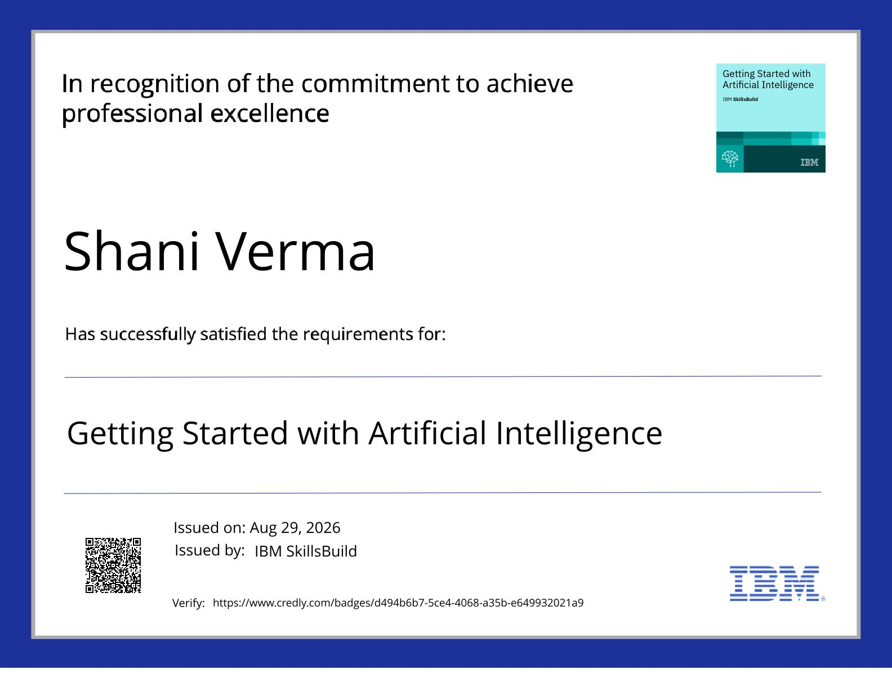
Certificates Earned:
Please add your credly certificate(Getting Started with Artificial Intelligence)

Slide 19

Certificates Earned:​
Add your IBM BOB Certificate

Slide 20


